Slide 1

FEM compliant Examiner briefing before a Multipilot & Single Pilot high performance complex aircraft test

Slide 2


Escape Routes
AED
Fire Extinguisher
Emergency Stop
Escape Rope
Calling for help
Meeting point
Notes:
This briefing is intended to expose the threats there are – both during real time flying or in a simulator.
It is a MUST that the pilot´s know escape routes. Where the EAD is, how will leave the aircraft/SIM first.
SAFETY MATTERS

Slide 3
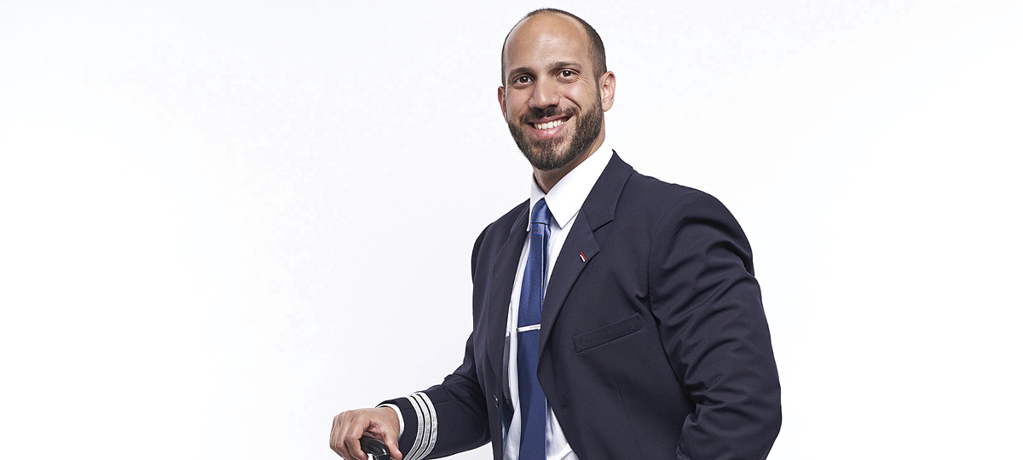
Fit for flight?
Notes:
ALWAYS ask if crew is Fit for flight!!! If not – cancel the session. Remember you are holding their career in your hand. Stress? Sleep? Nutrition? If not fit- CANCEL

Slide 4

ID - Check
Notes:
A must if you don´t know the crew. If Colleagues from same company who you know – then it´s a different story

Slide 5
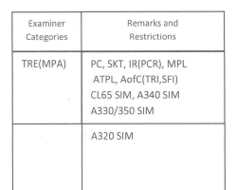
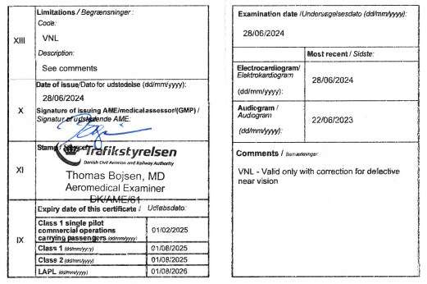
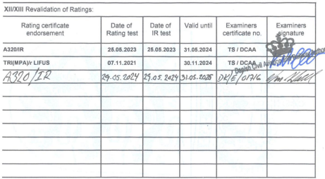
Check of the pilot's licence
Notes:
There have been multiply cases where an examiner does not hold a valid rating himself – so by presenting your documentation to the candidate it will be a reminder for your self. Remember – valid OPC, Medical and Instructor/examiner rating. You are NOT allowed to perform test if your papers are not valid

Slide 6
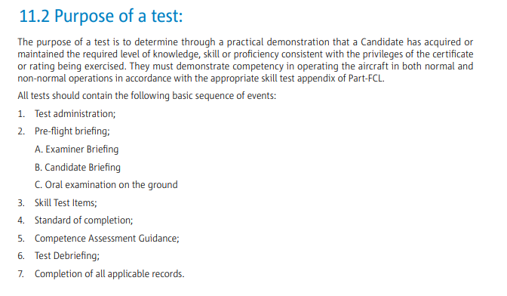
Todays Objective
Notes:
State objective

Slide 7

Objectives continued
Insert own data, e.g.,
Aircraft is LNRGL / SK 401
Flight from EKCH to ESSA
MEL is 52-09-37A
Weather is as follows
Notes:
Adjust for your flight

Slide 8

Notes:
FEM Demand / The freedom for the ‘candidate’ to ask questions must be emphasized.

Slide 9

Notes:
State what rules to be follow – FCOM/FCTM/OMA (FEM Text: Operating procedures to be followed (for example operators manual)

Slide 10

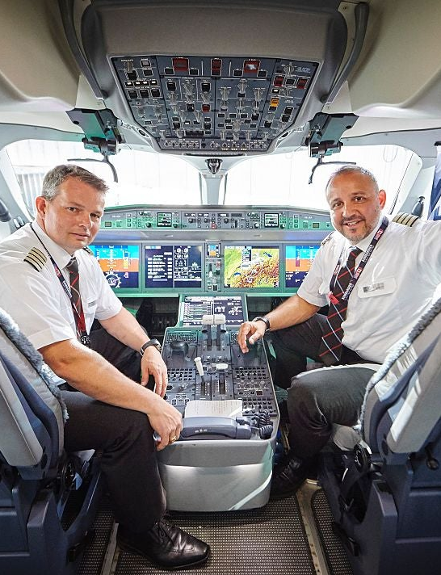
Roles today
Notes:
Respective roles of the Candidate and the Examiner during the test (for example during emergency) – observe following: When conducting a test in an aircraft, the respective roles of the Examiner and Candidate must be clearly defined, particularly with respect to real or simulated emergencies. For flight tests, there must always be a clear understanding of who has control of the aircraft. Prior to flight, the pilots involved should conduct a briefing that includes reviewing the procedures for exchanging flight controls.

Slide 11
Maneuvers:
RTO
EFATO
3 x Abnormals
3 x Emergencies
LDG - OEI
MAN GA / OEI
Raw Data
3D if SKT
2D Approach
1 must be RNP
3D Approach MAN OEI

Slide 12
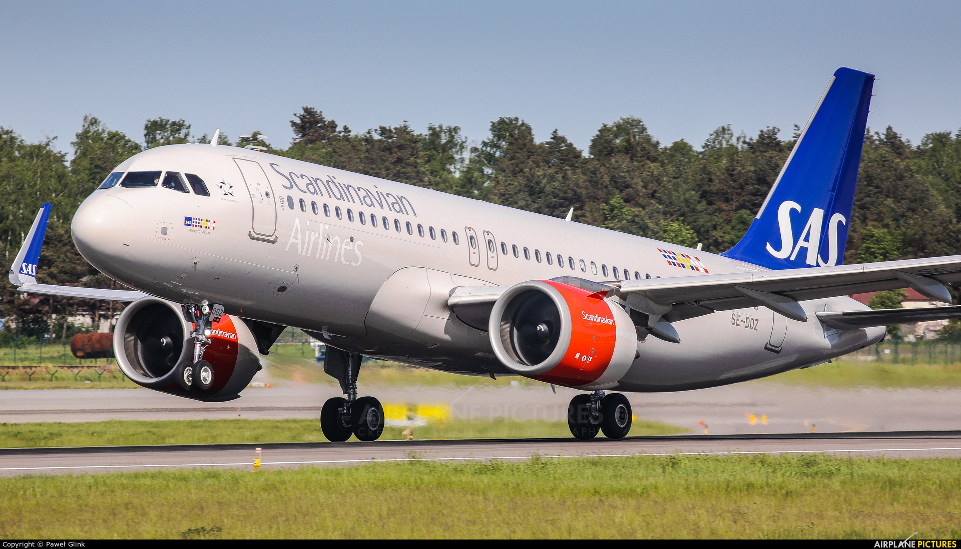
Standard of Completion
The Candidate shall demonstrate the ability to:
a) operate the aeroplane within its limitations;
b) complete all manoeuvres with smoothness and accuracy
c) exercise good judgement, airmanship & decision making;
d) apply aeronautical knowledge;
e) maintain control of the aeroplane at all times in such a manner that the successful outcome of a procedure or manoeuvre is always assured;
f) understand and apply TEM techniques, crew coordination and incapacitation procedures; and
g) communicate effectively with the other crew members

Slide 13
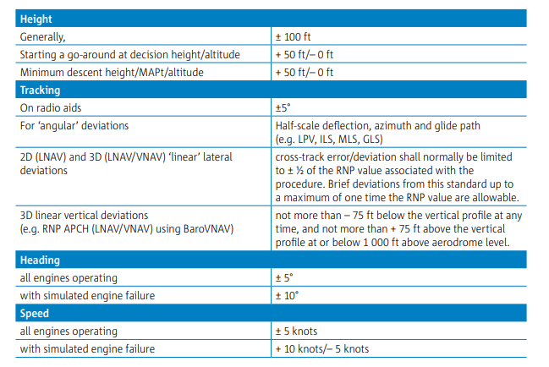
The following limits shall apply, corrected to make allowance for turbulent conditions and the handling qualities and performance of the aeroplane used

Slide 14
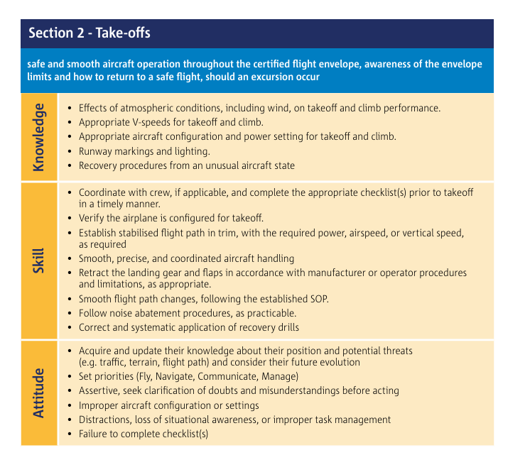
EASA describes K-A-S for each section

Slide 15
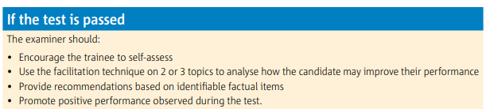
Passed test

Slide 16
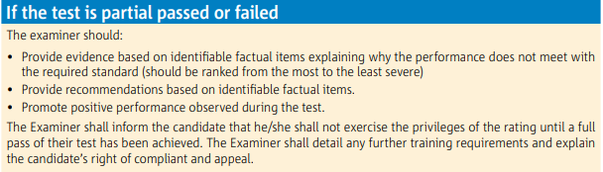
Partial passed pr failed test

Slide 17
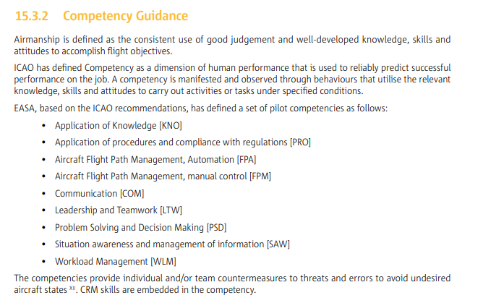

Slide 18
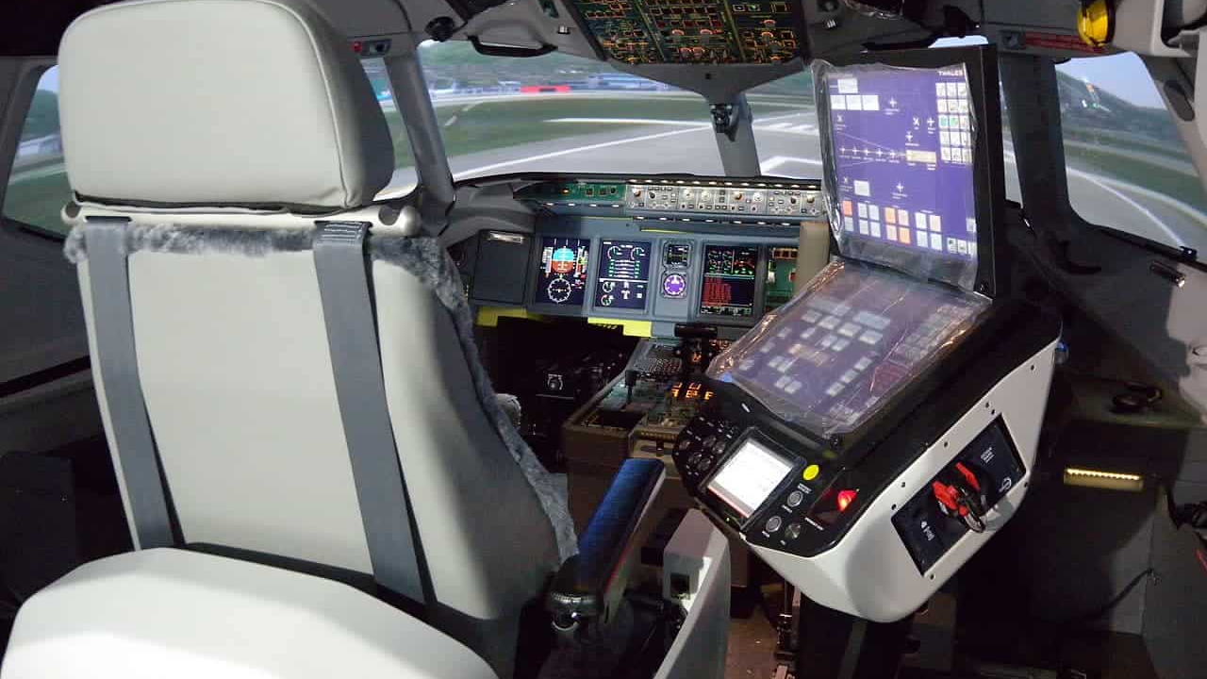
Simulator Differencies

